Slide 1
Time Management & Boolean Arithmetic
Time Management, Binary and Boolean Arithmetic, Circuits for Adding Binary Numbers, Making Decisions in Hardware

Slide 2


Connect With Your CSE 390B Peers
Download Discord from https://discord.com/download
Log in or create an account
Click on icon in left-most column to create channel
  Select “Create My Own”
  Select “For me and my friends”
  Give your server a name! (e.g., “CSE 390B 22sp”)
Use the button to invite peers
Create some text and voice channels. Some ideas:
  Text: #projects, #questions, #chill, #random
  Voice: 🔊 Study Room, 🔊 Lounge
Feel free to connect via Slack, Messenger, etc. too

Slide 3
Project 2 Check-in
How has Project 2 been going?
What questions do you have about Project 2?
  HardwareSimulator or GitLab setup-related issues?
You’ll discuss with your TA about the Study Skills Inventory and revisit it at the end of the quarter
Read Part II Tips for guidance on how to begin technical portion

Slide 4
Lecture Outline
Time Management
  Weekly Time Commitments
Binary and Boolean Arithmetic
  Addition Operator and Overflow
Circuits For Adding Binary Numbers
  Half Adder, Full Adder
Making Decisions in Hardware
  Multiplexer (Mux) Logical Gate

Slide 5

Time Management
One of your most precious resources is your time.

Slide 6
WHAT TYPICALLY FILLS UP YOUR TIME DURING THE QUARTER?
CLASS LECTURES & QUIZ SECTIONS
WORKING
STUDYING
FAMILY COMMITMENTS
OFFICE HOURS
EXTRACURRICULAR INVOLVEMENT
COMMUTING
HOME CHORES
FRIENDS/PARTNERS
ADMINISTRATIVE WORK
PHYSICAL / MENTAL ACTIVITIES
AND MORE!

Slide 7
Weekly Time Commitments

Slide 8
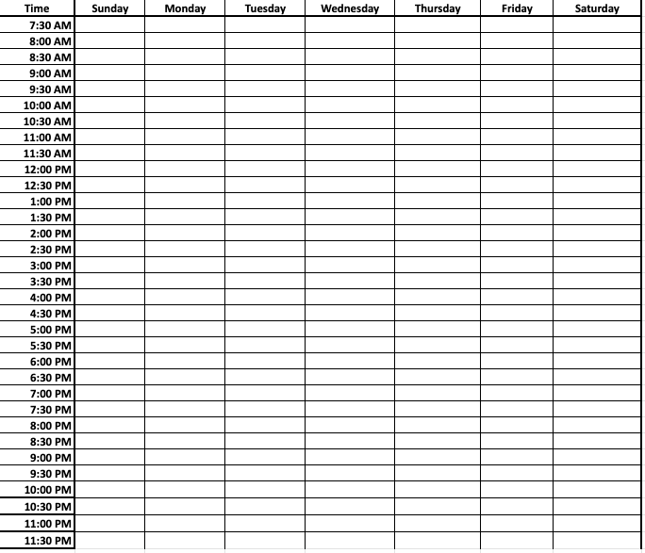
Weekly Time Commitments

Slide 9
Weekly Time Commitments
Class meeting times and quiz sections
Family, friends, community, extracurricular commitments
Physical and Mental Activities
Studying for each of your classes
  The number of credits for a course reflects the number of hours the class meets
  In general, courses require two hours of homework for every one hour of class
What else is not reflected given your specific situation?

Slide 10
Time Management Group Discussion
Now that you’ve filled out your weekly time commitments, discuss in groups of 3-4:
  What is one thing that is most surprising to you?
  What is one thing you might change?
  How might you use this time commitments sheet in the future?

Slide 11
Lecture Outline
Time Management
  Weekly Time Commitments
Binary and Boolean Arithmetic
  Addition Operator and Overflow
Circuits For Adding Binary Numbers
  Half Adder, Full Adder
Making Decisions in Hardware
  Multiplexer (Mux) Logical Gate

Slide 12
What is the binary representation of the decimal value of 29?
0b011011
0b011101
0b100011
0b100111
We’re lost…

Slide 13
What is Binary?
A base n number system is a system of number representation with n symbols
Decimal system is a base 10 number system
  Base 10 symbols: 0, 1, 2, 3, 4, 5, 6, 7, 8, 9 (each called a digit)
  Increase a number by moving to the next greatest symbol
  Add another digit when we run out of symbols
Binary is a base 2 number system
  Base 2 symbols: 0, 1 (each called a bit)
  Often prefixed with 0b (e.g., 0b1101, 0b10)
  Least-significant bit (LSB): Lowest-order position of a binary value
  Most-significant bit (MSB): Highest-order position of a binary value

Slide 14
Representing Numbers in Base 2
Binary numbers are identical, except in base 2
  Describe a value by specifying multiples of powers of 2
  For example, a breakdown of 0b1101 in binary (13 in decimal)
Binary | Power of 2 | Decimal | Power of 10
0b0001 | 1 × 2⁰ | 1 | 1 × 10⁰
0b0010 | 1 × 2¹ | 2 | 2 × 10⁰
0b0100 | 1 × 2² | 4 | 4 × 10⁰
0b1000 | 1 × 2³ | 8 | 8 × 10⁰

Slide 15
Representing Numbers in Binary
Binary | Decimal
0b000 | 0
0b001 | 1
0b010 | 2
0b011 | 3
0b100 | 4
0b101 | 5
0b110 | 6
0b111 | 7
... | ...

Slide 16
Roadmap: Boolean Arithmetic
Addition
Subtraction
Comparison (<, >, ==, !=)
Multiplication
Division
Implement
Get it for free!
Get it for free!
Postpone to software
Postpone to software

Slide 17
Binary Addition
How do we add two binary numbers?
  As humans, we could convert to decimal and then back
Example: 0b101 + 0b010
  First convert 0b101 to decimal (result is 5)
  Next convert 0b010 to decimal (result is 2)
  Add the decimal numbers and convert back to binary
    5 + 2 = 7, which is 0b111 in binary
What’s more useful is understanding the rules of binary addition so we can teach them to a computer

Slide 18
Case Study: Decimal Addition
Consider how we perform decimal addition
  Right to left (least significant place to most significant place)
  When a result is more than one digit, carry the “overflow”
carry
a | 5 | 7 | 8 | 3
b | 2 | 4 | 5 | 6
sum

Slide 19
Binary Addition
Binary addition is conceptually the same as decimal addition
  Right to left (least significant place to most significant place)
  When a result is more than one digit, carry the “overflow”
carry
a | 0 | 1 | 1 | 1
b | 0 | 1 | 0 | 1
sum

Slide 20
Binary Overflow
What if there’s a carry bit in the last column?
carry
a | 0 | 1 | 1 | 0
b | 1 | 0 | 1 | 0
sum

Slide 21
Binary Overflow
What if there’s a carry bit in the last column?
We can’t represent it in our fixed-width numbers
  We are going to “drop” or ignore the extra carry bit
carry
a |  | 0 | 1 | 1 | 0
b |  | 1 | 0 | 1 | 0
sum

Slide 22
Five-minute Break!
Feel free to stand up, stretch, use the restroom, drink some water, review your notes, or ask questions
We’ll be back at:
Any song recommendations? Respond on Poll Everywhere at https://pollev.com/cse390b
Research shows mid-lecture breaks reduce the decline of attention (Olmsted, 1999)
Olmsted III, John. “The Mid-Lecture Break: When Less Is More.” Journal of Chemical Education (1999). https://pubs.acs.org/doi/abs/10.1021/ed076p525.

Slide 23
Lecture Outline
Time Management
  Weekly Time Commitments
Binary and Boolean Arithmetic
  Addition Operator and Overflow
Circuits For Adding Binary Numbers
  Half Adder, Full Adder
Making Decisions in Hardware
  Multiplexer (Mux) Logical Gate

Slide 24
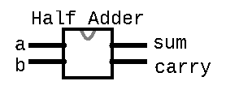
Half Adder
Circuit for adding two bits together
Takes in two inputs: a, b
  a is the first bit being added
  b is the corresponding bit to be added
carry
a | 0 | 1 | 1 | 0
b | 1 | 0 | 1 | 0
sum
Produces two outputs: sum, carry
  sum is the value to be put for this column in the result
  carry is the value to be carried over to the next column
/**
* Computes the sum of 2 bits
*/
CHIP HalfAdder {
  IN a, b;
  OUT sum, carry;
  PARTS:
  // Put your code here:
  }

Slide 25
Half Adder Example
Example: 0b0111 + 0b0101
For the right-most (least significant) column:
  a = 1
  b = 1
  sum =
  carry =
carry
a | 0 | 1 | 1 | 1
b | 0 | 1 | 0 | 1
sum

Slide 26
Half Adder Example
Boolean expressions:
  sum =
  carry =
a | b | sum | carry
0 | 0
0 | 1
1 | 0
1 | 1

Slide 27
Half Adder Group Work
Determine the half adder logical Boolean expression
  First, fill in the truth table values for sum and carry based on the inputs
  Then, develop a Boolean expression for sum and carry based on the truth table
Five-minute group discussion, identify one person to share each of the following as a large group:
  Overview of what the half adder does
  Thought process for reaching the Boolean expression for sum
  Thought process for reaching the Boolean expression for carry

Slide 28
Half Adder Example
Boolean expressions:
  sum = a XOR b
  carry = a AND b
a | b | sum | carry
0 | 0 | 0 | 0
0 | 1 | 1 | 0
1 | 0 | 1 | 0
1 | 1 | 0 | 1

Slide 29
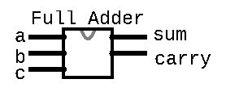
Full Adder
Circuit for adding three bits together (two bits and carry bit together from previous column)
  a is the first bit being added
  b is the corresponding bit to be added
  c is the carry bit from the right column
carry
a | 0 | 1 | 1 | 0
b | 1 | 0 | 1 | 0
sum
Produces two outputs: sum, carry
  sum is the value to be put for this column in the result
  carry is the value to be carried over to the next column
/**
* Computes the sum of 3 bits
*/
CHIP FullAdder {
  IN a, b, c;
  OUT sum, carry;
  PARTS:
  // Put your code here:
  }

Slide 30
Full Adder
Example: 0b0111 + 0b0101
For the second (second least significant) column:
  a = 1
  b = 0
  c = 1
  sum =
  carry =
carry |  |  | 1
a | 0 | 1 | 1 | 1
b | 0 | 1 | 0 | 1
sum |  |  |  | 0

Slide 31
Full Adder Truth Table
a | b | c | sum | carry
0 | 0 | 0
0 | 0 | 1
0 | 1 | 0
0 | 1 | 1
1 | 0 | 0
1 | 0 | 1
1 | 1 | 0
1 | 1 | 1

Slide 32
What are the sum and carry bits when a=0, b=1, and c=1?
a | b | c | sum | carry
0 | 0 | 0
0 | 0 | 1
0 | 1 | 0
0 | 1 | 1 | ? | ?
1 | 0 | 0
1 | 0 | 1
1 | 1 | 0
1 | 1 | 1
sum = 0, carry = 0
sum = 0, carry = 1
sum = 1, carry = 0
sum = 1, carry = 1
We’re lost…

Slide 33
What are the sum and carry bits when a=0, b=1, and c=1?
a | b | c | sum | carry
0 | 0 | 0
0 | 0 | 1
0 | 1 | 0
0 | 1 | 1 | 0 | 1
1 | 0 | 0
1 | 0 | 1
1 | 1 | 0
1 | 1 | 1
sum = 0, carry = 0
sum = 0, carry = 1
sum = 1, carry = 0
sum = 1, carry = 1
We’re lost…

Slide 34
Full Adder Truth Table
a | b | c | sum | carry
0 | 0 | 0 | 0 | 0
0 | 0 | 1 | 1 | 0
0 | 1 | 0 | 1 | 0
0 | 1 | 1 | 0 | 1
1 | 0 | 0 | 1 | 0
1 | 0 | 1 | 0 | 1
1 | 1 | 0 | 0 | 1
1 | 1 | 1 | 1 | 1

Slide 35
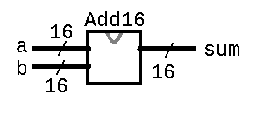
Multi-Bit Adder
Adds two 16-bit numbers
Connects the full adders for each column together (wires the out carry from one column to the in carry of the next)
/**
* Adds two 16-bit Two’s Complement
* values. Overflow is ignored.
*/
CHIP Add16 {
  IN a[16], b[16];
  OUT sum[16];
  PARTS:
  // Put your code here:
  }
… 0 0 1 1 1 0
… 0 0 1 0 1 0 1
… 1 0 1 1 1 0 0
+
… 1 1 1 0 0 0 1

Slide 36
Lecture Outline
Time Management
  Weekly Time Commitments
Binary and Boolean Arithmetic
  Addition Operator and Overflow
Circuits For Adding Binary Numbers
  Half Adder, Full Adder
Making Decisions in Hardware
  Multiplexer (Mux) Logical Gate

Slide 37
Making Decisions in Hardware
We write if / else statements in Java with the understanding that only one of the branches will run
  For example, in the following code, we expect to compute one of a & b or a | b (not both)
In hardware, all circuits are always executing
  We can’t “turn off” a circuit based on a condition
  Instead, we create circuits for different conditions and choose which output based on a condition instead
if (c == 0) {
out = a & b;
} else {
out = a | b;
}

Slide 38
Making Decisions in Hardware
We can use a Multiplexer (Mux) gate to choose which singular input to output
  Takes three inputs: a, b, and sel
  If sel == 0, then out = a
  Otherwise, out = b
A Demultiplexer (DMux) gate passes one input to one of several outputs and 0 to the rest of the outputs
  Takes two inputs: in and sel
  If sel == 0, then a = in and b = 0
  Otherwise, a = 0 and b = in
a
0
Mux
out
b
1
sel
a
0
in
DMux
1
b
sel

Slide 39
Mux Gate Implementation Example
Example of converting pseudocode into a hardware circuit diagram:
if (c == 0) {
out = a & b;
} else {
out = a | b;
}

Slide 40
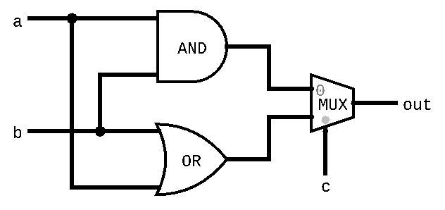
Mux Gate Implementation Example
Example of converting pseudocode into a hardware circuit diagram:
if (c == 0) {
out = a & b;
} else {
out = a | b;
}

Slide 41
Mux Gate Practice Problem 1
Draw out the hardware circuit diagram that corresponds to the following pseudocode:
if (c == 0) {
out = ~a | ~b;
} else {
out = a | b;
}

Slide 42
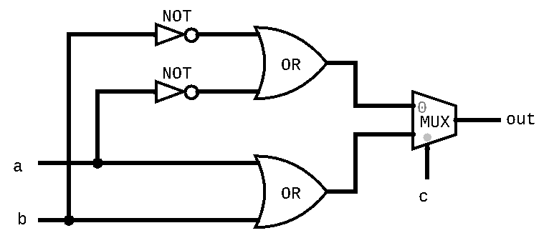
Mux Gate Practice Problem 1
Draw out the hardware circuit diagram that corresponds to the following pseudocode:
if (c == 0) {
out = ~a | ~b;
} else {
out = a | b;
}

Slide 43
Mux Gate Practice Problem 2
Draw out the hardware circuit diagram that corresponds to the following pseudocode:
if (a == b) {
out = a & b;
} else {
out = a | b;
}

Slide 44
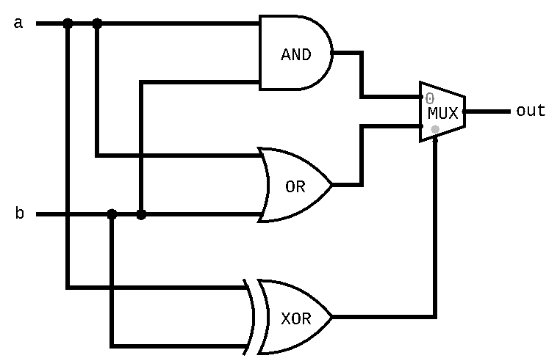
Mux Gate Practice Problem 2
Draw out the hardware circuit diagram that corresponds to the following pseudocode:
if (a == b) {
out = a & b;
} else {
out = a | b;
}

Slide 45
Lecture 3 Wrap-up
Project Reminders
  Project 1 feedback released on Gradescope
  Project 2 due this Thursday (4/7) at 11:59pm PDT
Lecture 4 Reading: Negative Numbers in Binary
Course Staff Support
  Eric has office hours in CSE2 153 today after lecture until 5pm
  You can also post your questions on the Ed discussion board

